Slide 1


Lexical Analysis in Translators for C++
Concepts, tooling, and practical implementation essentials
Notes:
Image source: AI-generated

Slide 2

Understanding Lexical Analysis in Translators
Notes:
Definition and Role in Language Processing, Position of Lexical Analysis in the Compilation Pipeline, Key Terminology: Lexemes, Tokens, Patterns

Slide 3
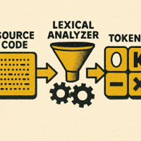
Lexical Analysis
Definition
Initial compiler phase that reads a character stream and groups it into lexemes.
From Lexemes to Tokens
The analyzer converts each lexeme into a token, a symbolic unit for parsing.
Role in Processing
Abstracts low-level characters into high-level tokens, simplifying syntax and semantic analysis.
Notes:
Lexical analysis is the initial phase of a compiler or interpreter where the input source code is read as a stream of characters and divided into meaningful sequences called lexemes. The analyzer converts lexemes into tokens, which are symbolic representations used by the parser for syntax analysis. It plays a critical role in simplifying the complexity of language processing by abstracting detailed characters into high-level tokens, enabling easier syntactic and semantic analysis. Image source: AI-generated

Slide 4
Lexical Analysis in the Compilation Pipeline
01
Lexical Analysis
Converts source characters into tokens; catches malformed or illegal characters early.
02
Syntax Analysis
Builds a parse tree from tokens, validating grammatical structure of the code.
03
Semantic Analysis
Checks types, scopes, and meanings to ensure logically consistent programs.
04
Optimization
Improves intermediate code for performance or size without changing behavior.
05
Code Generation
Emits target machine code or bytecode from the optimized representation.
Notes:
Lexical analysis is the first phase in the typical multi-stage compilation pipeline, occurring before syntax analysis, semantic analysis, optimization, and code generation. Positioned right after the source code input, it serves as a foundational step that breaks down code into tokens, which the parser relies on. This placement is crucial since errors caught during lexical analysis improve overall compiler robustness by early detection of malformed tokens or illegal characters.

Slide 5





Key Terminology: Lexemes, Tokens, Patterns
Lexeme
A sequence of characters in source code that matches a pattern, such as 'count' or '123'. Example: The word 'while' in 'while (x > 0)' is a lexeme.
Token
A category assigned to a lexeme, representing its type (e.g., identifier, keyword, integer). Example: 'while' is classified as a 'keyword' token.
Pattern
A rule (often a regular expression) that lexemes must match to be recognized as tokens. Example: '[A-Za-z_][A-Za-z0-9_]*' for identifiers.
Interrelationships
Patterns define valid lexemes; lexemes are classified into tokens. Together, they enable lexical analysis in compilers.
Notes:
A lexeme is the contiguous sequence of characters in the source text that matches the pattern for a token. Tokens represent the category or type of lexeme (e.g., an integer literal, identifier, or keyword). Patterns, often defined via regular expressions, describe the syntactic structure lexemes must follow to be recognized as valid tokens. These concepts form the backbone of lexical analysis, enabling precise pattern matching and token generation. Image source: AI-generated

Slide 6
The Importance of Tokenization
Notes:
Simplifying Syntax Analysis and Parsing, Error Detection and Reporting in Early Stages, Enabling Language-Independent Processing

Slide 7
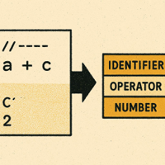
Simplifying Syntax Analysis and Parsing
Tokenization streamlines parsing
Converts raw code into tokens so parsers handle symbols, not characters.
Enables formal grammars
Distinct tokens align with grammar rules and parser generators.
Improves efficiency and accuracy
Tokens abstract whitespace and comments, reducing ambiguity and cost.
Visual model: code → tokens
Side-by-side image illustrates simplified input for parsers.
Notes:
Tokenization reduces the complexity of parsing by transforming raw source code into a manageable stream of tokens. This simplification allows parsers to work with distinct symbols instead of raw characters, facilitating the use of formal grammar rules and parser generators. It improves parsing efficiency and accuracy, as tokens abstract irrelevant details like whitespace and comments. Image source: AI-generated

Slide 8
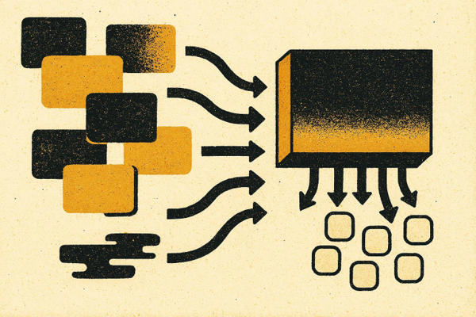
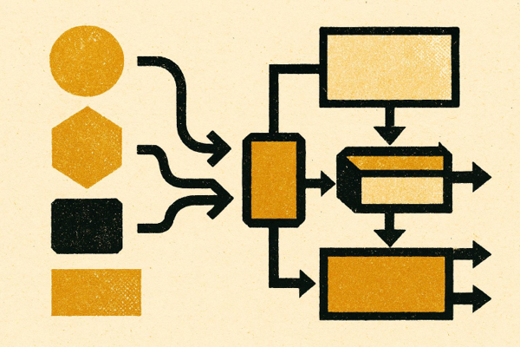
Enabling Language-Independent Processing
Language-Specific Lexical Analysis
The lexer adapts to language syntax and emits standardized tokens that abstract raw source text.
Language-Independent Parsing Modules
Parsers and semantic analyzers reuse the token interface, enabling modularity, flexibility, and scalability.
Notes:
A well-designed lexical analyzer abstracts language-specific character sequences into tokens, enabling language-independent parsing and analysis modules. This separation allows the reuse of parsers and semantic analyzers across different languages with only the lexer adapted. Modern compiler infrastructures frequently adopt this modular approach for flexibility and scalability. Image source: AI-generated

Slide 9
Conceptual Steps in Lexical Analysis
Notes:
Input Stream Scanning and Character Grouping, Matching Patterns to Token Types, Handling Whitespace, Comments, and Delimiters

Slide 10
Input Stream Scanning and Grouping
01
Buffering
Characters are temporarily stored for efficient access and lookahead.
02
Lookahead
Lexer examines upcoming characters to resolve ambiguities.
03
Character Grouping
Characters are grouped into lexemes based on rules.
04
Lexeme Recognition
Identified lexemes are matched to token types.
05
Token Output
Tokens are emitted for further syntactic analysis.
Notes:
Lexical analyzers process the raw input stream character by character, grouping characters into lexemes based on predefined rules. Techniques such as lookahead and buffering optimize scanning efficiency while handling ambiguous sequences. Efficient scanning algorithms are fundamental to maintaining compilation speed, especially for large codebases.

Slide 11
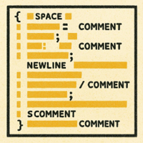
Handling Whitespace, Comments, and Delimiters
1 — Whitespace
Lexers skip spaces, tabs, and newlines to keep the token stream clean and focused.
2 — Comments
Single-line and multi-line comments are recognized and ignored without producing tokens.
3 — Delimiters
Semicolons and braces precisely mark token boundaries and statement grouping.
4 — Robust Scanning
A resilient lexer ignores irrelevant input while maintaining synchronization.
Notes:
Whitespace and comments typically do not produce tokens; they are recognized and skipped by the lexer to avoid cluttering the token stream. Proper handling of delimiters such as semicolons and braces ensures correct token boundaries. Robust lexical analyzers are designed to efficiently ignore irrelevant inputs without losing synchronization during scanning. Image source: AI-generated

Slide 12
Outline of Tokenization in Pseudocode
Notes:
High-Level Structure of a Lexical Analyzer, Common Control Flow for Scanning Input, Producing and Returning Tokens to the Parser

Slide 13
High-Level Structure of a Lexical Analyzer
Initialization
Set up data structures and prepare the input stream for processing.
Scanning & Pattern Matching
Read input characters, identify patterns, and recognize valid tokens.
Error Handling
Detect and manage invalid input or unexpected sequences.
Token Delivery
Pass recognized tokens to the parser for further analysis.
Notes:
The lexical analyzer typically consists of initialization, reading input, recognizing tokens, and delivering tokens to the parser modules. The high-level design emphasizes modularity with functions dedicated to scanning, pattern matching, and error handling, enabling clear flow and maintainability.

Slide 14
Lexing Algorithm
while currentChar is not EOF:
if currentChar is whitespace:
advance()
continue
if currentChar starts a comment:
skip comment
continue
if currentChar is a letter:
read identifier or keyword
emit token
continue
if currentChar is a digit:
read number
emit token
continue
if currentChar starts a string:
read string literal
emit token
continue
if currentChar begins a multi-character operator:
if longest valid operator matches:
emit operator token
advance appropriately
else:
emit single-character operator
advance()
continue
if currentChar is punctuation:
emit punctuation token
advance()
continue
report error
advance()

Slide 15

Producing and Returning Tokens to the Parser
Token Object Structure
Each produced token bundles a type, the matched lexeme, and optional position metadata, enabling precise downstream diagnostics and parser decisions.
Notes:
Once a lexeme matches a pattern, the lexer encapsulates the token type, lexeme value, and possibly its position metadata into a token object passed to the parser. The lexer maintains state to support lookahead or backtracking if supported. Efficient token production ensures smooth parser integration and overall compiler performance. Image source: AI-generated

